Slide 1

To demolish
拆除
or
还是
to preserve？
保留？
九班-第十五组
汇报：
蒋威 裘旸
胡楠 陆桓锐
文案： 蒋威 裘旸 胡楠
PPT制作：陆桓锐

Slide 2


menu
菜单
The introduction and our views
介绍及我们的观点
The influence of ancient buildings on the development of modern cities
古代建筑对现代城市发展的影响
The effective ways and the examples
有效的方法和实例

Slide 3

01
The introduction
引言

Slide 4

introduction
引言
With the development of Cities in China,
随着中国城市的不断发展，
the scale of cities continues to expand. But
城市规模不断扩大。但
this has created a major crisis for historical and cultural buildings.
这给历史和文化建筑带来了重大危机。
Many old and historic buildings are well protected in China. However, city planners always have to face the question whether old buildings should be demolished to make way for progress.
在中国，许多古老的历史建筑得到了很好的保护。然而，城市规划者总是面临一个难题，即是否应该拆除旧建筑以让位于发展。

Slide 5
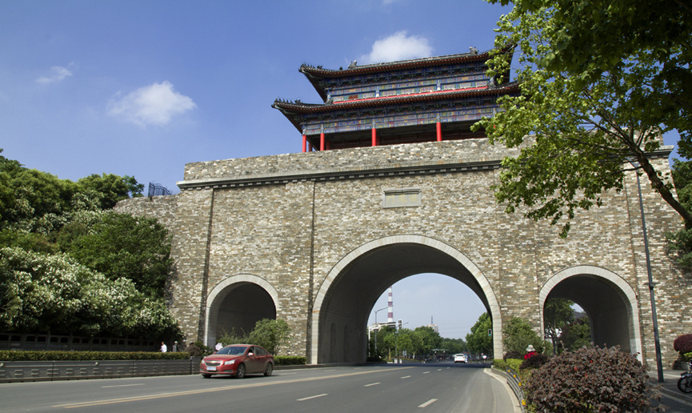

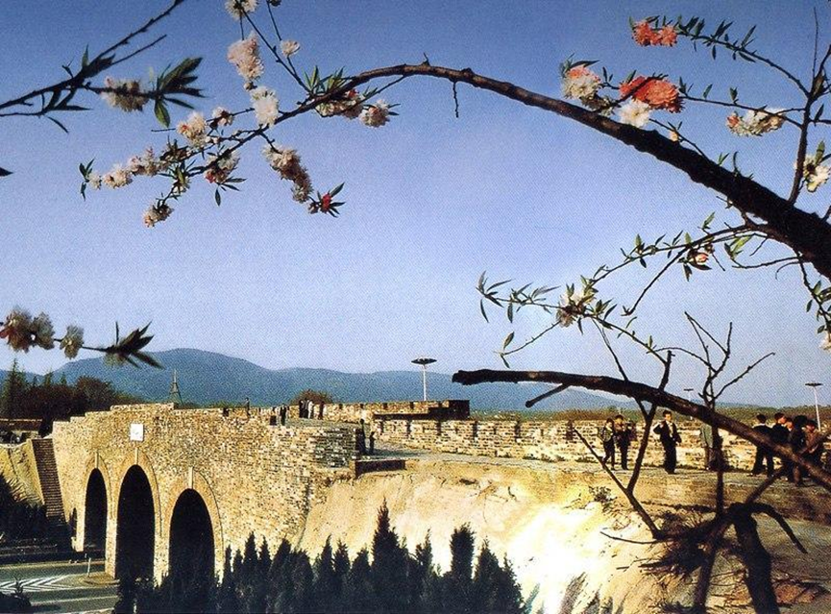
Nanjing ancient city wall
南京古城墙
Nanjing ancient city wall was built during the Ming Dynasty between 1366 and 1386.It is not only the largest city wall in China, but also the largest city wall in the world, and was selected as the world’s largest city wall by the World Records Association.In 1988, Nanjing ancient city wall was recognized as a national key cultural relics protection unit.
南京古城墙建于明朝1366年至1386年间。它不仅是中国最大的城墙，也是世界上最大的城墙，并被世界纪录协会选为世界上最大的城墙。1988年，南京古城墙被认定为全国重点文物保护单位。

Slide 6
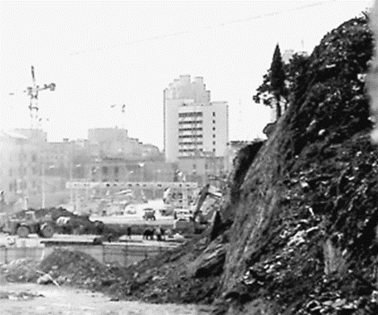
Nanjing ancient city wall
南京古城墙
But the city walls were also once demolished.On March 9, 2014, a large number of ancient city wall bricks were found in the demolition ruins of Meiyuan New Village(梅园新村) and Nanwei Lane（南卫巷） in Nanjing. And some of them were tragically damaged during the demolition and construction process.
但古城墙也曾一度被拆除。2014年3月9日，在南京梅园新村和南卫巷的拆迁废墟中发现了大量古城墙砖。其中一些在拆迁和施工过程中不幸受损。

Slide 7
There is sufficient factual evidence to prove that
有足够的事实证据证明
In the 1950s and 1960s, A large number of ancient buildings have been demolished in China.
在20世纪50年代和60年代，中国大量古建筑被拆除。
And our view is that
我们的观点是
Chinese ancient building should be preserved.
中国古建筑应得到保护。
We can find a balance between urbanization and preservation of ancient buildings, instead of demolish them ruthlessly.
我们可以在城市化与古建筑保护之间找到平衡，而不是无情地拆除它们。

Slide 8
02
The influence
影响

Slide 9
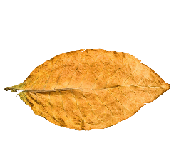
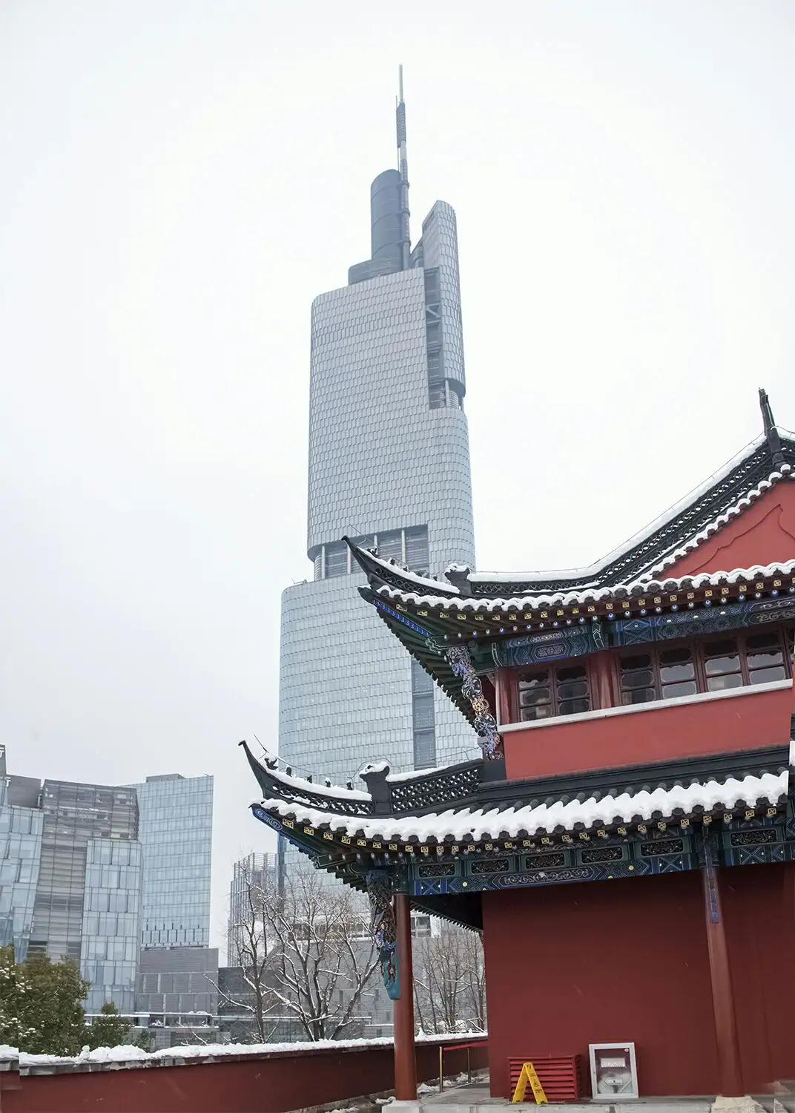
Economic impact
经济影响
Own historical and cultural ancient architecture itself can promote the awareness of the city, through with the help of the local architecture has a long cultural history, and the overall impact of the city's environmental benefits for investment promotion and capital introduction, and promote the construction of city, ornamental value lead to the development of tourism industry, brings the development of the academic research value, and gradually penetrate in other ways, so as to promote urban economic development.
自身的历史文化古建筑可以提升城市的知名度，通过当地建筑悠久的文化历史，对城市环境的整体效益产生积极影响，促进投资和资本引进，推动城市建设，观赏价值带动旅游业的发展，带来学术研究价值的提升，并逐渐渗透到其他方面，从而促进城市经济发展。

Slide 10

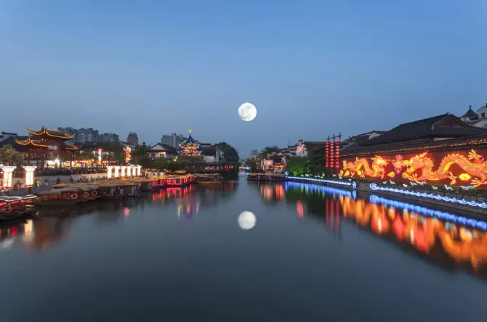
Cultural influence
文化影响
Chinese ancient architecture is an important material heritage in the history of human development. It is the most powerful evidence of the prosperity of a city and the landmark building of a city. Its historical culture is a symbol of the spiritual civilization of a city. As a landmark of the city, its historical culture, architectural aesthetics and other values are more and more worthy of our attention and protection.
中国古代建筑是人类发展历史中重要的物质遗产。它是城市繁荣的最有力证据，也是城市的标志性建筑。其历史文化是城市精神文明的象征。作为城市的地标，其历史文化、建筑美学等价值越来越值得我们关注和保护。

Slide 11

Conclusion
结论
With the progress and development of modern society, the aesthetic, humanistic and historical value of ancient architecture is also constantly explored. At the same time, ancient architecture has played an immeasurable role in the development of urban tourism. As a landmark building of the city, it has a deep influence on the development of the city in economy, culture, art and other aspects. Generally speaking, ancient architecture plays an important role in the development of the city where it is located. As a human heritage, the architectural concept and cultural value contained in it promote the progress of human architecture, and it has an important reference value for modern architecture.
随着现代社会的进步和发展，古建筑的美学、人文和历史价值也不断被发掘。同时，古建筑在城市旅游业的发展中发挥了不可估量的作用。作为城市的地标建筑，它对城市在经济、文化、艺术等多方面的发展产生了深远影响。总体而言，古建筑在其所在城市的发展中发挥着重要作用。作为人类遗产，古建筑所蕴含的建筑理念和文化价值推动了人类建筑的进步，对现代建筑具有重要的参考价值。

Slide 12

Therefore,transforming ancient buildings into tourist attractions is an effective way to balance between city development and the protection of ancient buildings.
因此，将古建筑改造成旅游景点是平衡城市发展与古建筑保护的有效方法。

Slide 13
03
There are two successful examples
有两个成功的例子

Slide 14

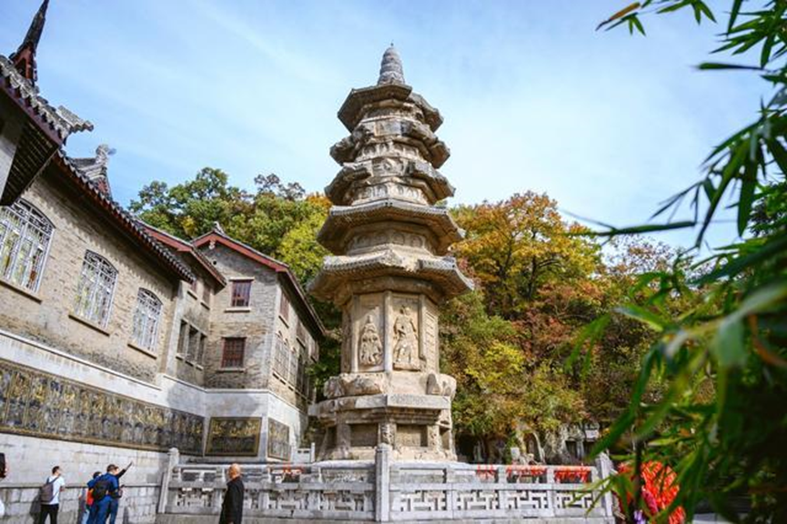
Qixia Temple
栖霞寺
Qixia Temple is located at the western foot of the middle peak of Qixia Mountain. Qixia Mountain has a beautiful ecological environment and is known as "the first Mingxiu Mountain in Jinling". In history, many scholars, emperors and generals visited here.
栖霞寺位于栖霞山中峰的西麓。栖霞山生态环境优美，被誉为“金陵第一明秀山”。历史上，许多学者、皇帝和将军曾到此游览。

Slide 15
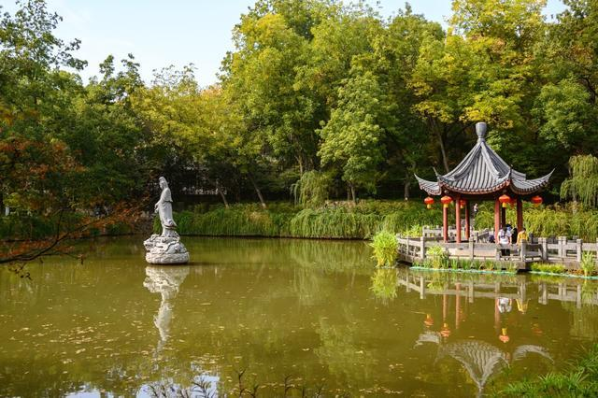
Qixia Temple
栖霞寺
During the War of Resistance, it sheltered over 20,000 civilians from the flames of war. After the founding of the People’s Republic of China, the government funded the renovation of most of the temples and turned the surrounding area into qixia Mountain Scenic area, which not only protected the ancient buildings but also brought abundant revenue for the city’s development.
在抗日战争期间，它为超过2万名平民提供了避难所。中华人民共和国成立后，政府出资修缮了大部分寺庙，并将周边地区改造成栖霞山风景区，不仅保护了古建筑，还为城市的发展带来了丰厚的收入。

Slide 16
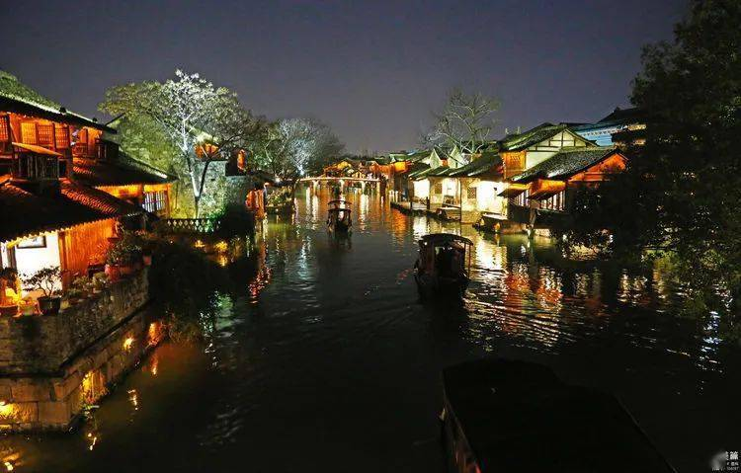
Wuzhen Town
乌镇
Wuzhen,located in Jiaxing City, Zhejiang Province,is a famous historical and cultural town in China. Wuzhen repaired damaged old streets and houses with old materials and traditional craftsmanship and restored or rebuilt of parts of old buildings.
乌镇位于浙江省嘉兴市，是中国著名的历史文化名镇。乌镇使用旧材料和传统工艺修复了受损的老街和房屋，并对部分老建筑进行了修复或重建。

Slide 17
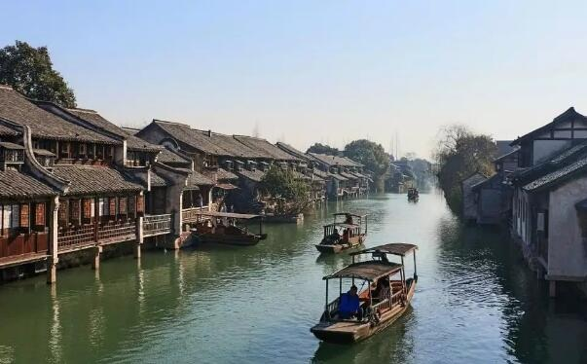
Wuzhen Town
乌镇
Wuzhen well restored and maintained the original appearance of the ancient town, perfectly shows the beauty of Jiangnan Water Town. When it rains, the hazy beauty seems to be in the ink painting.
乌镇很好地恢复并保持了古镇的原始风貌，完美地展现了江南水乡的美丽。下雨时，朦胧的美景仿佛置身于水墨画中。

Slide 18

All in all,it is a good choice to preserving ancient buildings as tourist attractions forfinding a balance between urbanization and preservation of ancient buildings.
总的来说，将古建筑作为旅游景点保存是一个好选择，可以在城市化与古建筑保护之间找到平衡。

Slide 19
Questions
问题
1、Which examples were introduced?
1、介绍了哪些例子？
2、What are the aspects of the influence of ancient buildings?
2、古代建筑的影响有哪些方面？

Slide 20
Thanks for
感谢
watching
观看

